Slide 1
CSE-309 Operating Systems
Mohammad Shariful Islam
Lecturer, Department of CSE
Mobile: 01747612143
Email: sharifulruhan@gmail.com

Slide 2
Chapter 2: Operating-System Structures

Slide 3
Chapter 2: Operating-System Structures
Operating System Services
User Operating System Interface
System Calls
Types of System Calls
System Programs
Operating System Design and Implementation
Operating System Structure
Operating System Debugging
Operating System Generation
System Boot

Slide 4
Objectives
To describe the services an operating system provides to users, processes, and other systems
To discuss the various ways of structuring an operating system
To explain how operating systems are installed and customized and how they boot

Slide 5
Operating System Services
Operating systems provide an environment for execution of programs and services to programs and users.
One set of operating-system services provides functions that are helpful to the user:
User interface - Almost all operating systems have a user interface (UI).
Varies between Command-Line (CLI), Graphics User Interface (GUI), Batch, web-based.
Program execution - The system must be able to load a program into memory and to run that program, end execution, either normally or abnormally (indicating error)
I/O operations - A running program may require I/O, which may involve a file or an I/O device
Notes:
1….User interfaces in computing
In computer science and human-computer interaction, the user interface (of a computer program) refers to the graphical, textual and auditory information the program presents to the user, and the control sequences (such as keystrokes with the computer keyboard, movements of the computer mouse, and selections with the ?touchscreen) the user employs to control the program.
Types
Currently (as of 2005) the following types of user interface are the most common:
?Command-line interfaces, where the user provides the input by typing a ?command string with the computer keyboard and the system provide output by printing text on the computer monitor. Used for system administration tasks etc.
?Batch interfaces are non-interactive user interfaces, where the user specifies all the details of the batch job in advance to batch processing, and receives the output when all the processing is done. The computer does not prompt for further input after the processing has started.
?Graphical user interfaces (GUI), which accept input via devices such as computer keyboard and mouse and provide articulated [graphical] output on the [computer monitor]. There are at least two different principles widely used in GUI design: object-oriented interfaces and application]] oriented interfaces.
Web-based user interfaces, which accept input and provide output by generating web pages which are transported via the Internet and viewed by the user using a ?web browser program.
2….A batch job can be completed without user intervention. For example, consider a telephone billing application that reads phone call records from the enterprise information systems and generates a monthly bill for each account. Since this application does not require any user interaction, it can run as a batch job.
3…. Batch processing is where the processing happens of blocks of data that have already been stored over a period of time. For example, processing all the transaction that have been performed by a major financial firm in a week. This data contains millions of records for a day that can be stored as a file or record etc. This particular file will undergo processing at the end of the day for various analysis that firm wants to do. Obviously it will take large amount of time for that file to be processed.

Slide 6
Operating System Services (Cont.)
One set of operating-system services provides functions that are helpful to the user (Cont.):
File-system manipulation - Programs need to read and write files and directories, create and delete them, search them, list file Information, permission management.
Communications – Processes may exchange information, on the same computer or between computers over a network
Communications may be via shared memory or through message passing (packets moved by the OS)
Error detection – OS needs to be constantly aware of possible errors
May occur in the CPU and memory hardware, in I/O devices, in user program
For each type of error, OS should take the appropriate action to ensure correct and consistent computing
Debugging facilities can greatly enhance the user’s and programmer’s abilities to efficiently use the system

Slide 7
Operating System Services (Cont.)
Another set of OS functions exists for ensuring the efficient operation of the system itself via resource sharing
Resource allocation - When multiple users or multiple jobs running concurrently, resources must be allocated to each of them
Many types of resources - CPU cycles, main memory, file storage, I/O devices.
Accounting - To keep track of which users use how much and what kinds of computer resources
Protection and security - The owners of information stored in a multiuser or networked computer system may want to control use of that information, concurrent processes should not interfere with each other
Protection involves ensuring that all access to system resources is controlled
Security of the system from outsiders requires user authentication, extends to defending external I/O devices from invalid access attempts

Slide 8
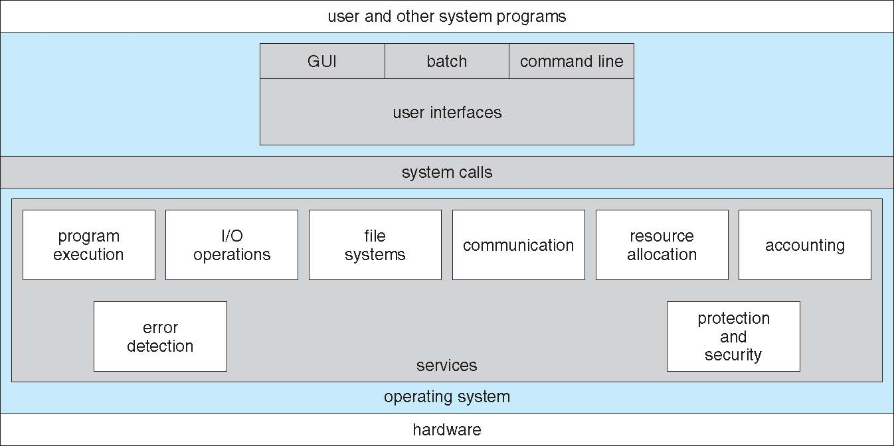
A View of Operating System Services

Slide 9
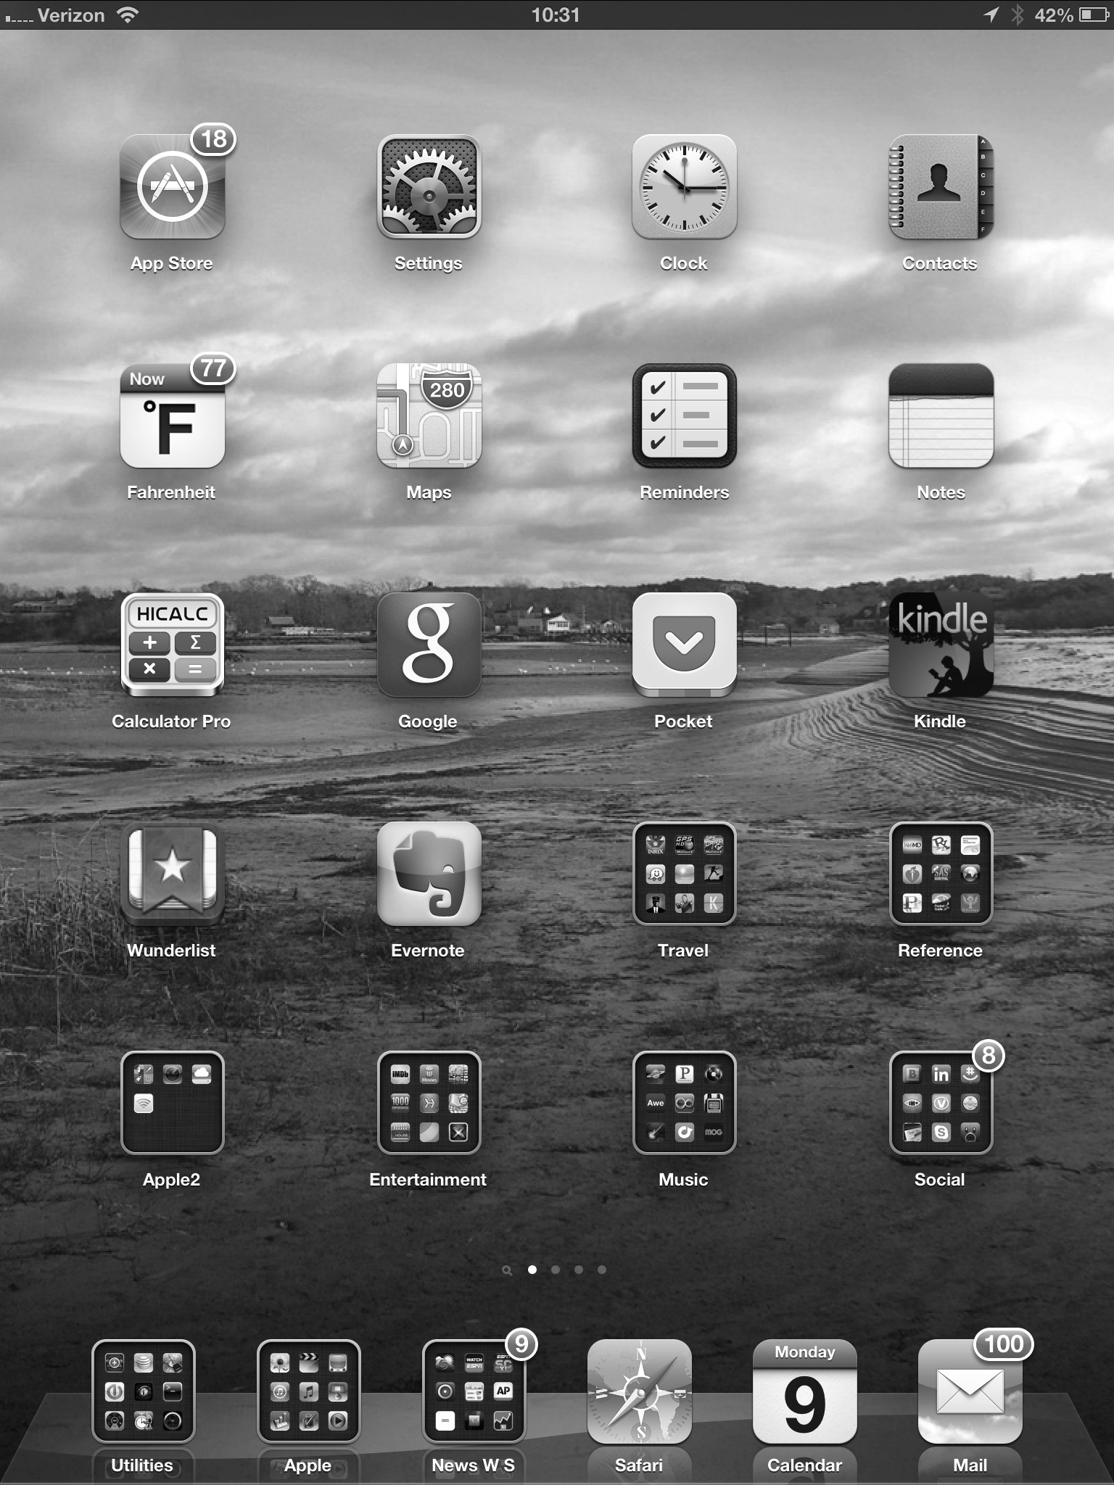
Touchscreen Interfaces
Touchscreen devices require new interfaces
Mouse not possible or not desired
Actions and selection based on gestures
Virtual keyboard for text entry
Voice commands.

Slide 10
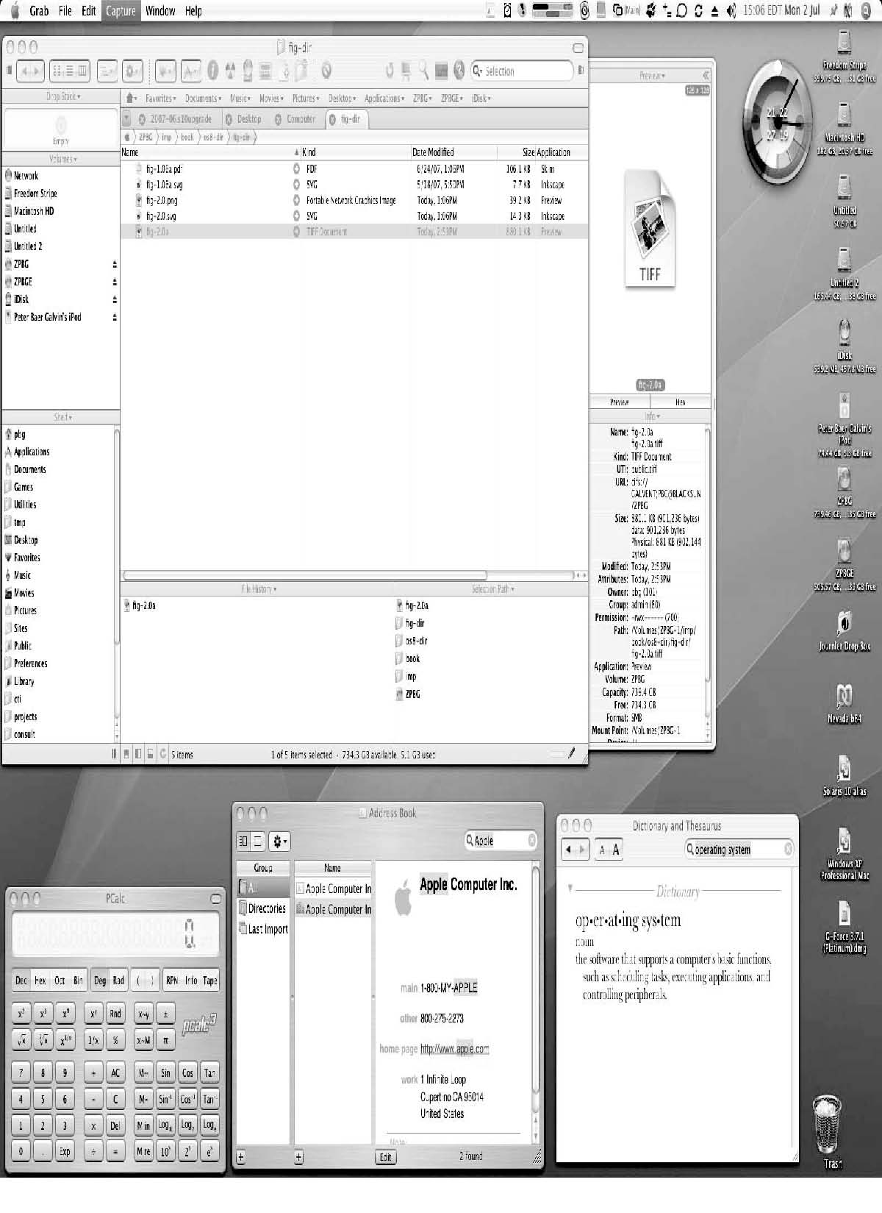
The Mac OS X GUI

Slide 11
System Calls
As we know that for performing any operation as user must have to specify the operation which he wants to operate on the computer.
We can say that for performing any operation a user must have to request for a service from the system.
For making any request a user will prepare a special call.
The system call is the request for running any program and for performing any operation on the system.
When a user first time starts the system then the system is in the user mode and when he request for a service then the user mode will be converted into the kernel mode which just listen the request of the user and process the request and display the results those are produced after the processing.
When a user request for opening any folder or when a moves his mouse on the screen, then this is called as the system call which he is using for performing any operation.
Notes:
A system call is a way for programs to interact with the operating system.
A computer program makes a system call when it makes a request to the operating system’s kernel.
System call provides the services of the operating system to the user programs via Application Program Interface(API).

Slide 12
Example of System Calls
System calls (or syscalls) are function calls made from user space programs into the kernel requesting for some service.
Examples: Open( ), read( ), write( ), fork( ), lseek( ), clone( ), wait( ), etc..
Three most common APIs are Win32 API for Windows, POSIX API for POSIX-based systems (including virtually all versions of UNIX, Linux, and Mac OS X), and Java API for the Java virtual machine (JVM)

Slide 13
System Call Implementation
Typically, a number associated with each system call
System-call interface maintains a table indexed according to these numbers
The system call interface invokes the intended system call in OS kernel and returns status of the system call and any return values
The caller need know nothing about how the system call is implemented
Just needs to obey API and understand what OS will do as a result call
Most details of OS interface hidden from programmer by API
Managed by run-time support library (set of functions built into libraries included with compiler)

Slide 14
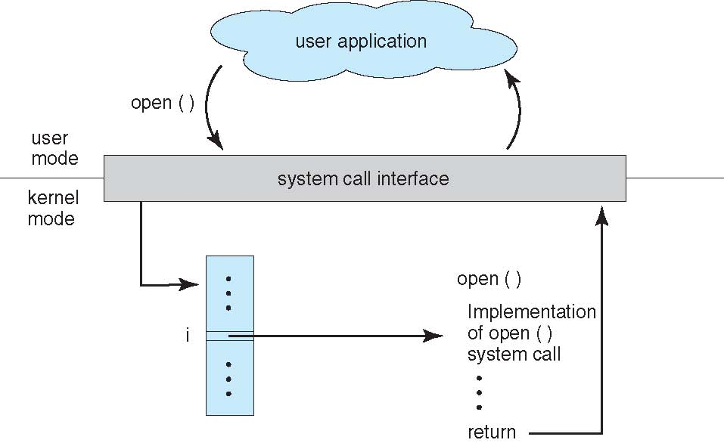
API – System Call – OS Relationship

Slide 15
Types of System Calls
Process control
create process, terminate process
end, abort
load, execute
get process attributes, set process attributes
wait for time
wait event, signal event
allocate and free memory
Dump memory if error
Debugger for determining bugs, single step execution
Locks for managing access to shared data between processes

Slide 16
Types of System Calls
File management
create file, delete file
open, close file
read, write, reposition
get and set file attributes
Device management
request device, release device
read, write, reposition
get device attributes, set device attributes
logically attach or detach devices

Slide 17
Types of System Calls (Cont.)
Information maintenance
get time or date, set time or date
get system data, set system data
get and set process, file, or device attributes
Communications
create, delete communication connection
send, receive messages if message passing model to host name or process name
From client to server
Shared-memory model create and gain access to memory regions
transfer status information
attach and detach remote devices
Protection
Control access to resources
Get and set permissions
Allow and deny user access

Slide 18
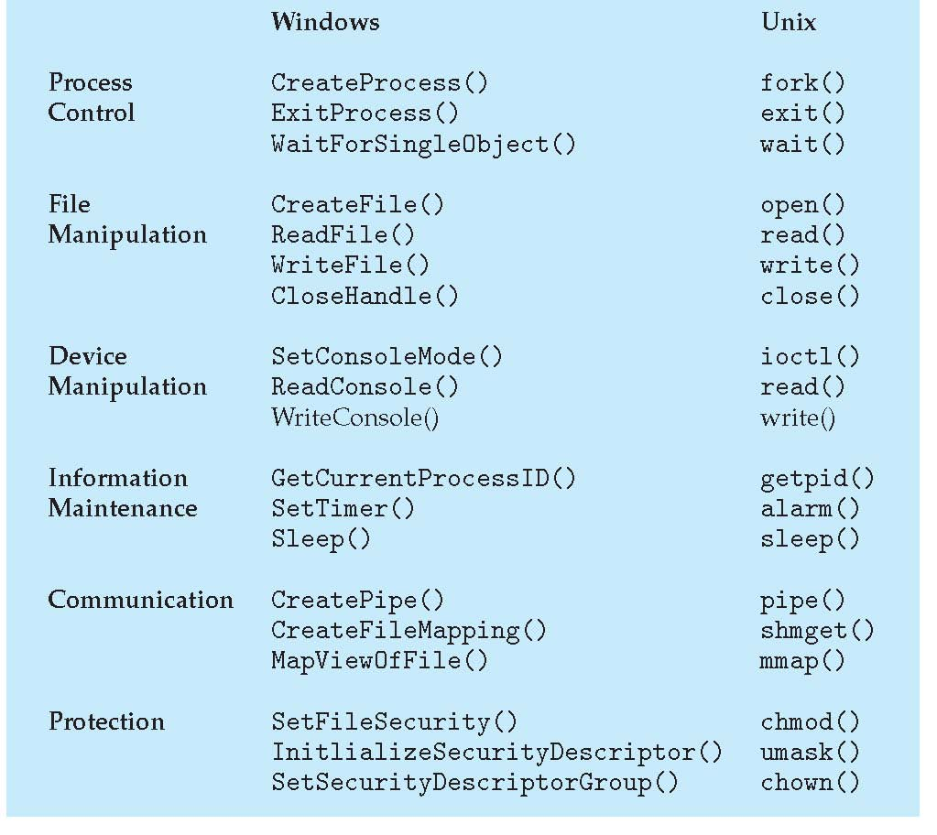
Examples of Windows and Unix System Calls

Slide 19
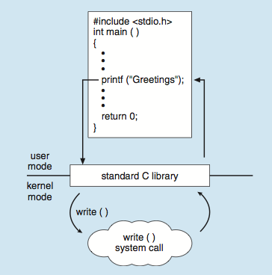
Standard C Library Example
C program invoking printf() library call, which calls write() system call

Slide 20
System Programs
System programs provide a convenient environment for program development and execution. They can be divided into:
File manipulation
Status information sometimes stored in a File modification
Programming language support
Program loading and execution
Communications
Background services
Application programs
Most users’ view of the operation system is defined by system programs, not the actual system calls

Slide 21
System Programs
Provide a convenient environment for program development and execution
Some of them are simply user interfaces to system calls; others are considerably more complex
File management - Create, delete, copy, rename, print, dump, list, and generally manipulate files and directories
Status information
Some ask the system for info - date, time, amount of available memory, disk space, number of users
Others provide detailed performance, logging, and debugging information
Typically, these programs format and print the output to the terminal or other output devices
Some systems implement a registry - used to store and retrieve configuration information

Slide 22
System Programs (Cont.)
File modification
Text editors to create and modify files
Special commands to search contents of files or perform transformations of the text
Programming-language support - Compilers, assemblers, debuggers and interpreters sometimes provided
Program loading and execution- Absolute loaders, relocatable loaders, linkage editors, and overlay-loaders, debugging systems for higher-level and machine language
Communications - Provide the mechanism for creating virtual connections among processes, users, and computer systems
Allow users to send messages to one another’s screens, browse web pages, send electronic-mail messages, log in remotely, transfer files from one machine to another

Slide 23
System Programs (Cont.)
Background Services
Launch at boot time
Some for system startup, then terminate
Some from system boot to shutdown
Provide facilities like disk checking, process scheduling, error logging, printing
Run in user context not kernel context
Known as services, subsystems, daemons
Application programs
Don’t pertain to system
Run by users
Not typically considered part of OS
Launched by command line, mouse click, finger poke

Slide 24
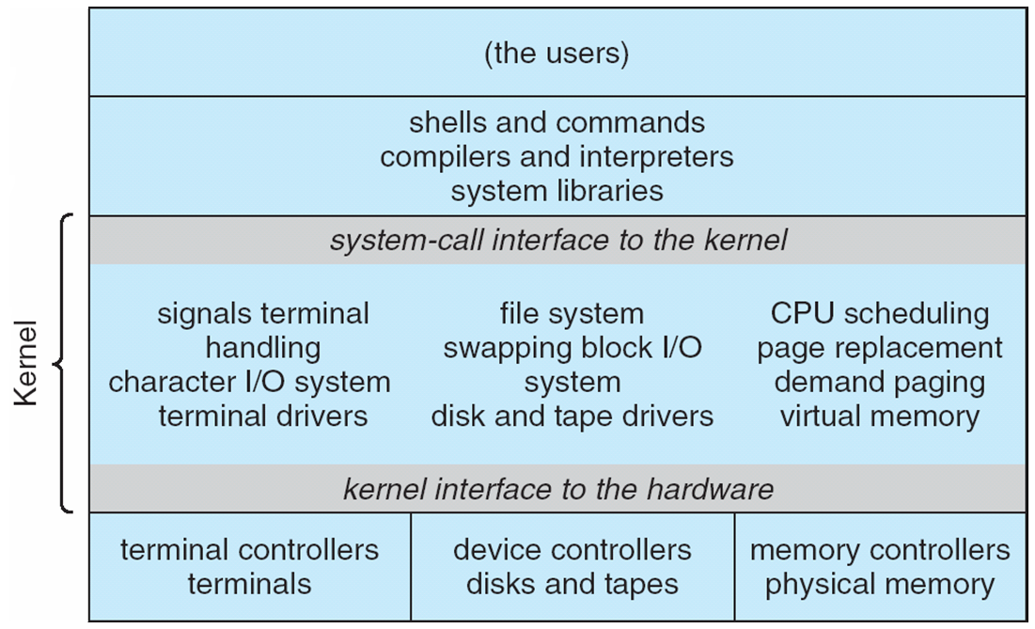
Traditional UNIX System Structure
Beyond simple but not fully layered

Slide 25
Operating-System Debugging
Debugging is finding and fixing errors, or bugs
OS generate log files containing error information
Failure of an application can generate core dump file capturing memory of the process
Operating system failure can generate crash dump file containing kernel memory
Beyond crashes, performance tuning can optimize system performance
Sometimes using trace listings of activities, recorded for analysis
Profiling is periodic sampling of instruction pointer to look for statistical trends
Kernighan’s Law: “Debugging is twice as hard as writing the code in the first place. Therefore, if you write the code as cleverly as possible, you are, by definition, not smart enough to debug it.”

Slide 26
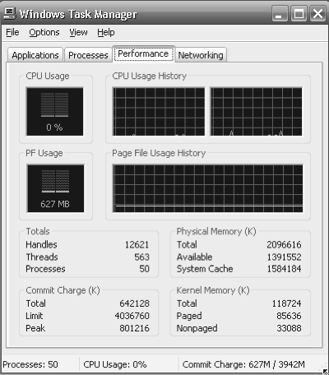
Performance Tuning
Improve performance by removing bottlenecks
OS must provide means of computing and displaying measures of system behavior
For example, “top” program or Windows Task Manager

Slide 27
System Boot
When power initialized on system, execution starts at a fixed memory location
Firmware ROM used to hold initial boot code
Operating system must be made available to hardware so hardware can start it
Small piece of code – bootstrap loader, stored in ROM or EEPROM locates the kernel, loads it into memory, and starts it
Sometimes two-step process where boot block at fixed location loaded by ROM code, which loads bootstrap loader from disk
Common bootstrap loader, GRUB, allows selection of kernel from multiple disks, versions, kernel options
Kernel loads and system is then running

Slide 28
Questions
Describe OS services that are helpful to the user.
Describe OS services that are helpful to OS itself.
Define system calls with examples.
Describe how system calls are implemented with a diagram.
Give some example of system calls that are used in windows and UNIX OS.
Make a list of some OS programs.
Define operating system debugging.

Slide 29
End of Chapter 2

